Slide 1

Final Project
14011104 윤호준

Slide 2

Contents
About my Location
Layout View of location
Adding Information

Slide 3
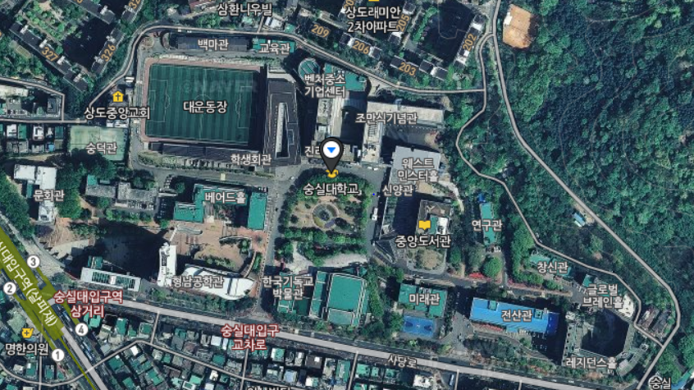
1. About my location
Location : SoongSil University

Slide 4
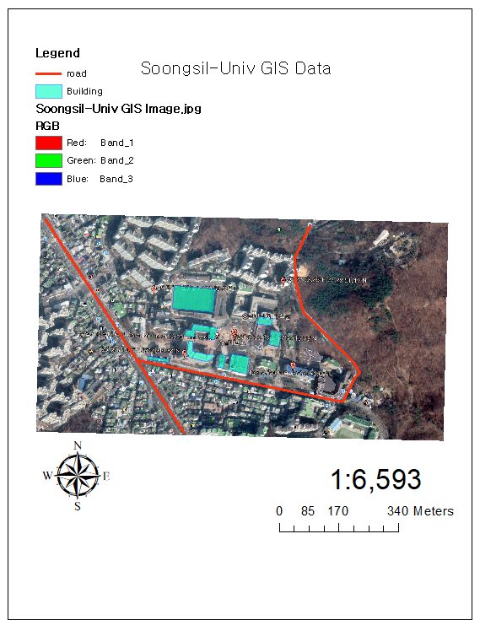
2. Layout view of location
Add Scale Bar, North Arrow, Scale Text and legend.
Make 2 layers, road & Building

Slide 5
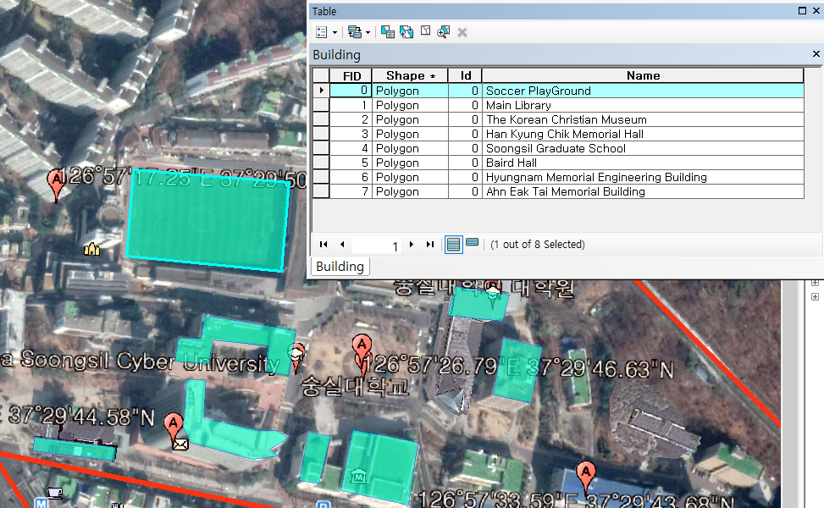
3. Adding information
Add 8 Buildings
Soccer Playground
Main Library
The Korean Christian Museum
Han Kyung Chik Memorial Hall
Soongsil Graduate School
Baird Hall
Hyungnam Memorial Engineering Building
Ahn Eak Tai Memorial Building

Slide 6
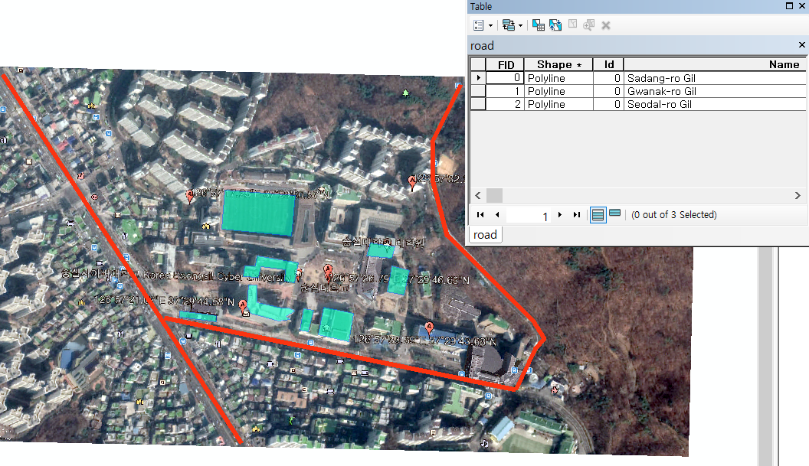
3. Adding information
Add 3 roads
Sadang-ro Gil
Gwanak-ro Gil
Seodai-ro Gil

Slide 7

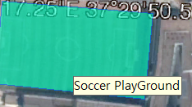
3. Adding information
Also, if you point each of buildings or roads, you can see the name of each of buildings or roads.

Slide 8
Thank you!

